Slide 1
Introduction to Arduino
A London Hackspace Production
by Andy “Bob The Builder” Brockhurst

Slide 2

Picture “Hardware Hacking”
by nicholasjon- flickr

Slide 3
Talk topics (in no particular order)
Introduction
  What is hardware hacking
  How to get started
Microprocessors
Sensors & Switches (Hardware I/O)
  The world is your mollusc
Basic Circuit Theory
  How to get those sensors to work

Slide 4
What is hardware hacking
Hacking
  An elegant solution to a difficult problem
  Using a technology for something it was not originally intended.

Slide 5
Types of hardware hacking
Just hacking hardware
Circuit Bending
Reverse Engineering
Toy Hacking
SteamPunk
Craft Hacking/“Making”

Slide 6

Photo: “WRT54G & NSLU2”
by lime*monkey- flickr

Slide 7
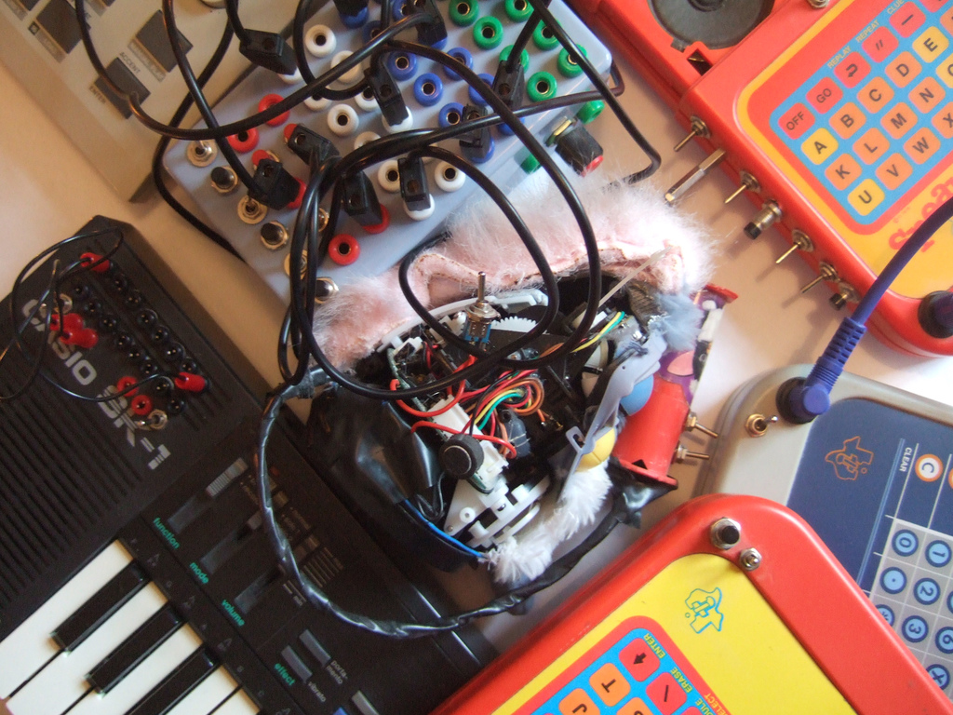
Picture “Circuit Bending”
by jamie_hladky- flickr

Slide 8

Picture “Toy Hacking”
by Vanderlin - flickr

Slide 9


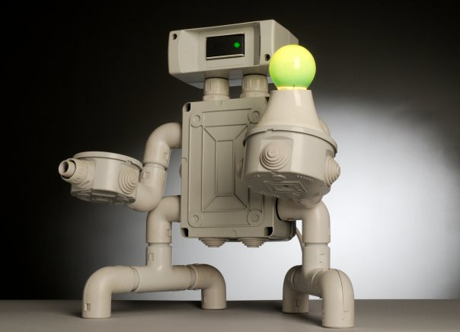

Picture “Making”

Slide 10

Photo: “Steampunk”
by Balakov- flickr

Slide 11

Picture “Reverse Engineering”
by Neal Connor- flickr

Slide 12
Getting Started
Arduino
  Entry level microprocessor
  OpenSource Hardware & Software
  14 digital Inputs/Outputs (6 PWM Out*)
  6 analogue Inputs
  IDE with loads of example code
  Aimed at artists/hobbyists with limited programming experience
  *We’ll come to this shortly

Slide 13
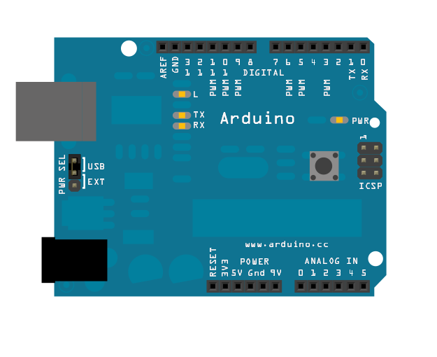
Arduino (Atmega 328)
16bit Microprocessor, Embedded C
32k Flash, 2k SRAM, 1k EEPROM
16Mhz

Slide 14
Arduinos are not the only fruit
Atmel Tiny (ATtiny)
PIC AVR (PICAXE)
Range of ARM processors
FPGA

Slide 15
Arduino
OpenSource Hardware
  Schematics freely available
  Lots of “Flavours”; Diecimila, Duemilanove, Mega, Mini, Nano, Lilypad
  Lots of boards for specific tasks; Motor/servos, Autonomous Vehicles, Robotics, Autopilots, CNC (*32 makers)
  Sheilds to extend functionality; Bluetooth, wifi, radio, ethernet, GPS, relays, LCD, touchscreen…

Slide 16
Arduino Initiatives
Software
  Processing
    IDE is based on Processing and Wiring
  Fritzing
    Prototyping and circuit layout
EduWear
  Introducing programming and electronics to children

Slide 17
Getting Inspiration
MakeZine
  http://blog.makezine.com/
Instructables
  http://www.instructables.com/
Circuit-Projects
  http://www.circuit-projects.com/
Tinker.it
  http://www.tinker.it/

Slide 18
Where to get stuff
Specialist Arduino Retailers (UK)
  http://www.earthshinedesign.co.uk/
  http://www.oomlout.co.uk/
Other Hardware suppliers (UK)
  http://www.active-robots.co.uk/
  http://www.techbotics.co.uk/
  http://www.technobots.co.uk/
  http://www.ebay.co.uk/

Slide 19
Hardware Hacking
Let’s build some stuff!

Slide 20
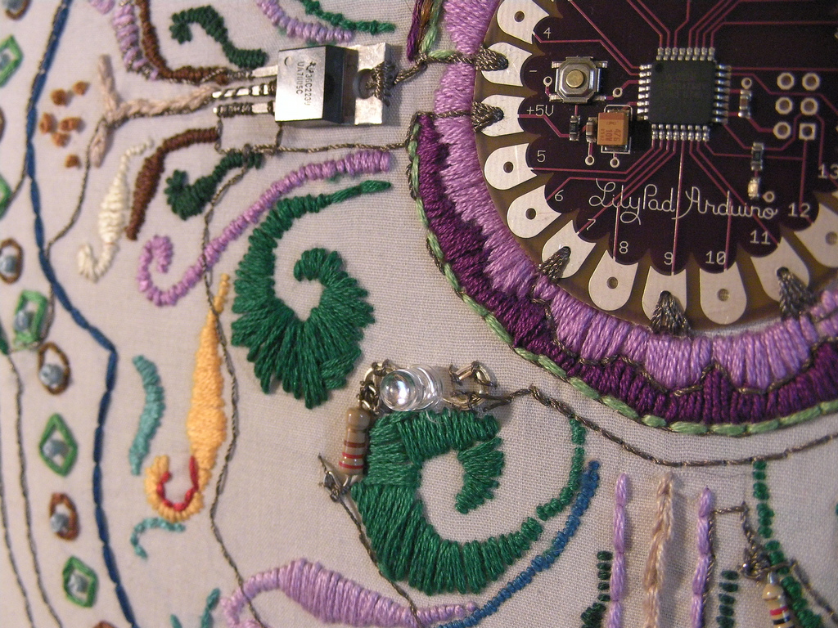
by Bekathwia - flickr

